Slide 1

OCTOBER 2025
LAS TRADERS
Evaluating Portfolio Optimization with In-Sample and Out-of-Sample Techniques
AILEEN LI, LUKE HARTFIELD, SAMAY MOHAPATRA
The University of Texas at Austin

Slide 2
INTRODUCTION
Built a portfolio optimization tool using real-world stock data from WRDS CRSP
Used both mean-variance optimization and Ledoit-Wolf shrinkage
Compared in-sample (IS) and out-of-sample (OOS) results with visualizations

Slide 3
USER INPUTS
User provides: stock tickers, in-sample and out-of-sample date ranges, and starting weights
Tickers, dates, weights checked for validity
In Plain English:
“What tickers are in your portfolio?”
“What percentage of your portfolio is invested into XYZ?”
…

Slide 4

DATA CLEANING
Pulled monthly returns, prices, and shares from CRSP (Center for Research in Security Prices)
Matched tickers to correct dates and handled delisting returns
Cleaned data: fixed negative prices, filled missing delisting returns, dropped missing regular returns

Slide 5
PORTFOLIO OPTIMIZATION
Weights
Returns
TICKERS | ORIGINAL | GMV | EFPORT | ORP
WMT | – | – | – | –
NVDA | – | – | – | –
AMD | – | – | – | –
MSFT | – | – | – | –
WEIGHTS | IS RETURNS | OS RETURNS
Original | w * μ | w * μ
GMV | w * μ | w * μ
EFPORT | w * μ | w * μ
ORP | w * μ | w * μ
Calculated with in-sample returns
x2 for LW

Slide 6
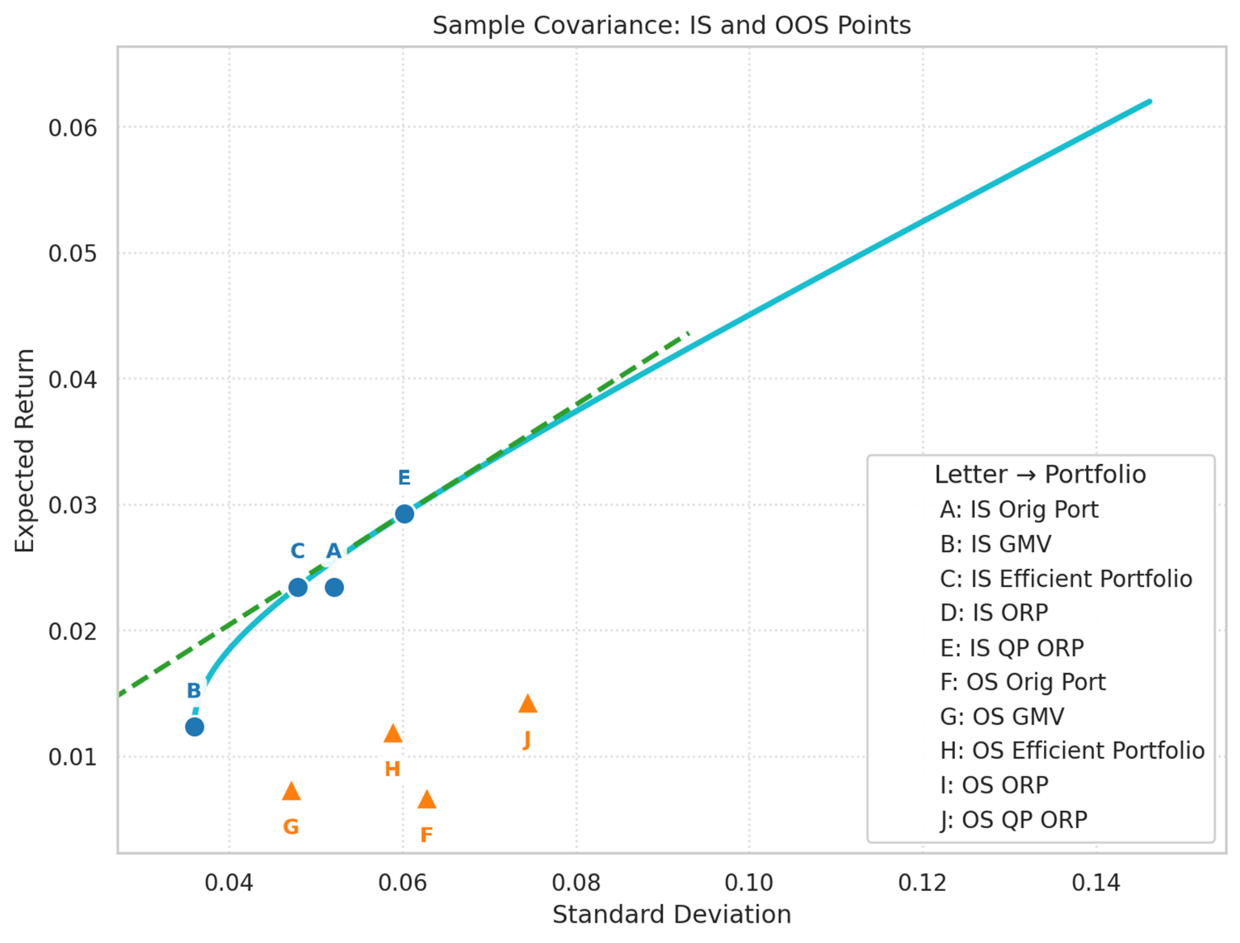
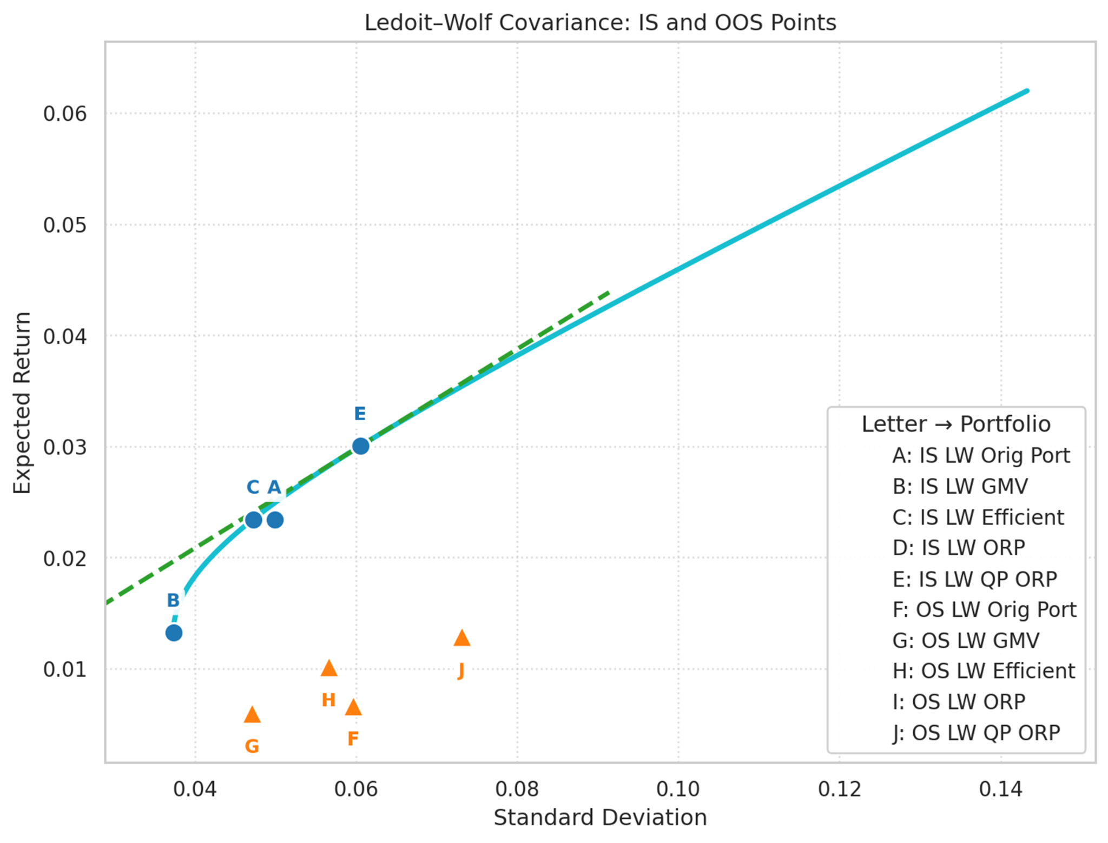
KEY FINDINGS
IS portfolios look strong, but OOS performance drops: returns are lower and risk is higher
This is due to estimation risk: weights fit to past data may not work on new data
Ledoit-Wolf shrinkage helps a bit, but can't remove all risk from changing markets
The more you update weights, the more you may pay in trading costs

Slide 7
LIMITATIONS
User inputs
Noise vs diversification
Decrease in risk does not Increase alpha
Constraints on weights

Slide 8
CONCLUSION
In-sample looks great, does not translate to out-of-sample
Shrinkage made weights smaller but did not always raise Sharpe
Constraints matter and can push to corner solutions
Other methods are needed to help mitigate overfitting and allow for generalization

Slide 9

MONTH 20XX
INSERT YOUR
HEADLINE HERE
UP TO 3 LINES
Insert your subtitle or any additional description text here up to
two lines of text or you can delete this text box
PRESENTER OR SPEAKER NAME
Position/Role, The University of Texas at Austin

